Slide 1
Introduction
What is Unity API and introduction to problem statement
Notes:
So before that, what are Unity API and the problem I will be focusing on.

Slide 2
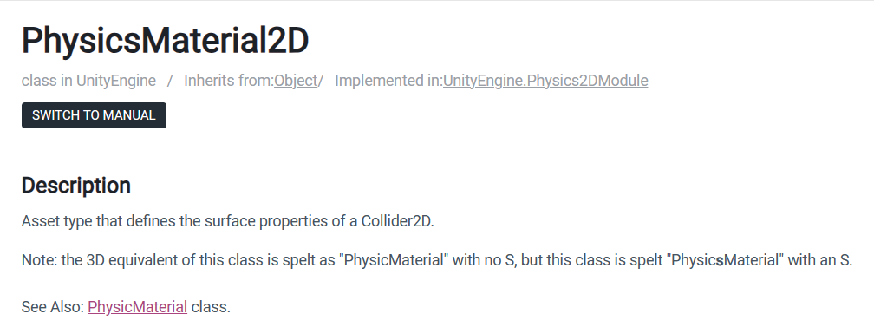
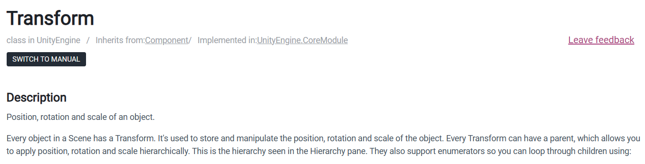
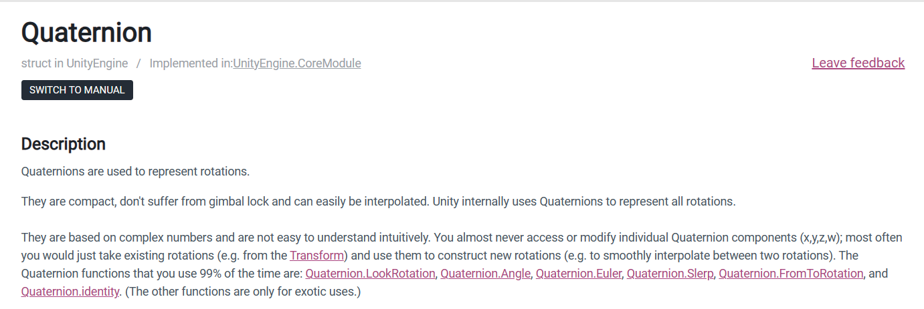
Unity API Explanation
Application Programming Interface (API) allows Developer to interact with programming tools to help them develop their application.
Unity has an extensive list of API for developer to create their games.
However, there is always drawbacks to the API.
Notes:
Well Unity API is an interface that allow developers using Unity to interact with the tools provided by Unity.
This can be things like Transform, Quaternion, Physics and sound. This is very helpful for developers as they
Can create games at lightning speed compared to traditional means. The API provided is vast and can help
Developers do all sorts of things. But there are some drawbacks.

Slide 3
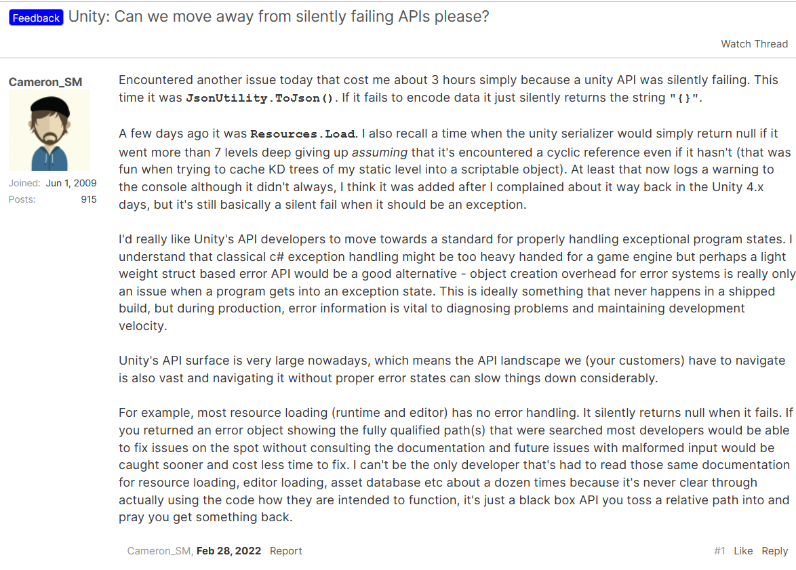
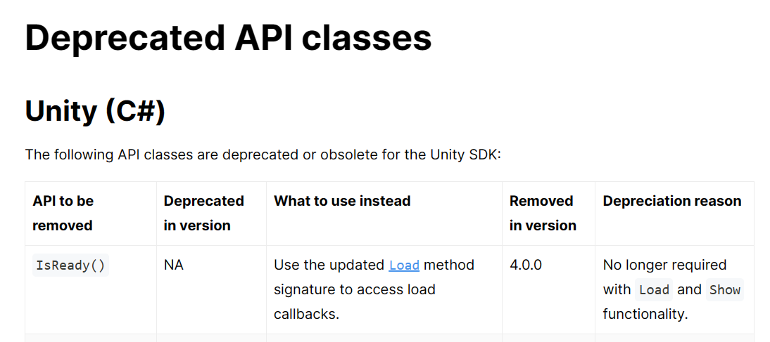
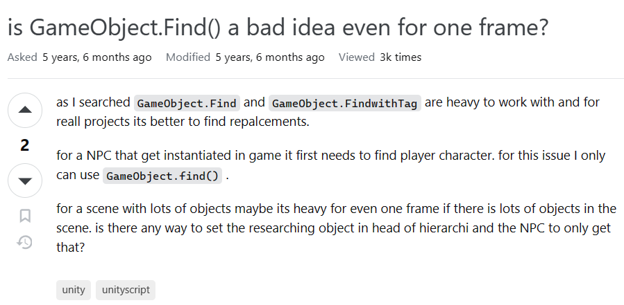
Drawbacks to using Unity API
Deprecated Code
Can’t resolve different situations.
Performance Issues
Notes:
This can be deprecated code based, problems that even Unity API can resolve such as Json.utility api and bad performance issues.

Slide 4
API Attack
Thom Low (2202423F)
Notes:
Hello my name is Thom and I will be going through my topic. API attack

Slide 5
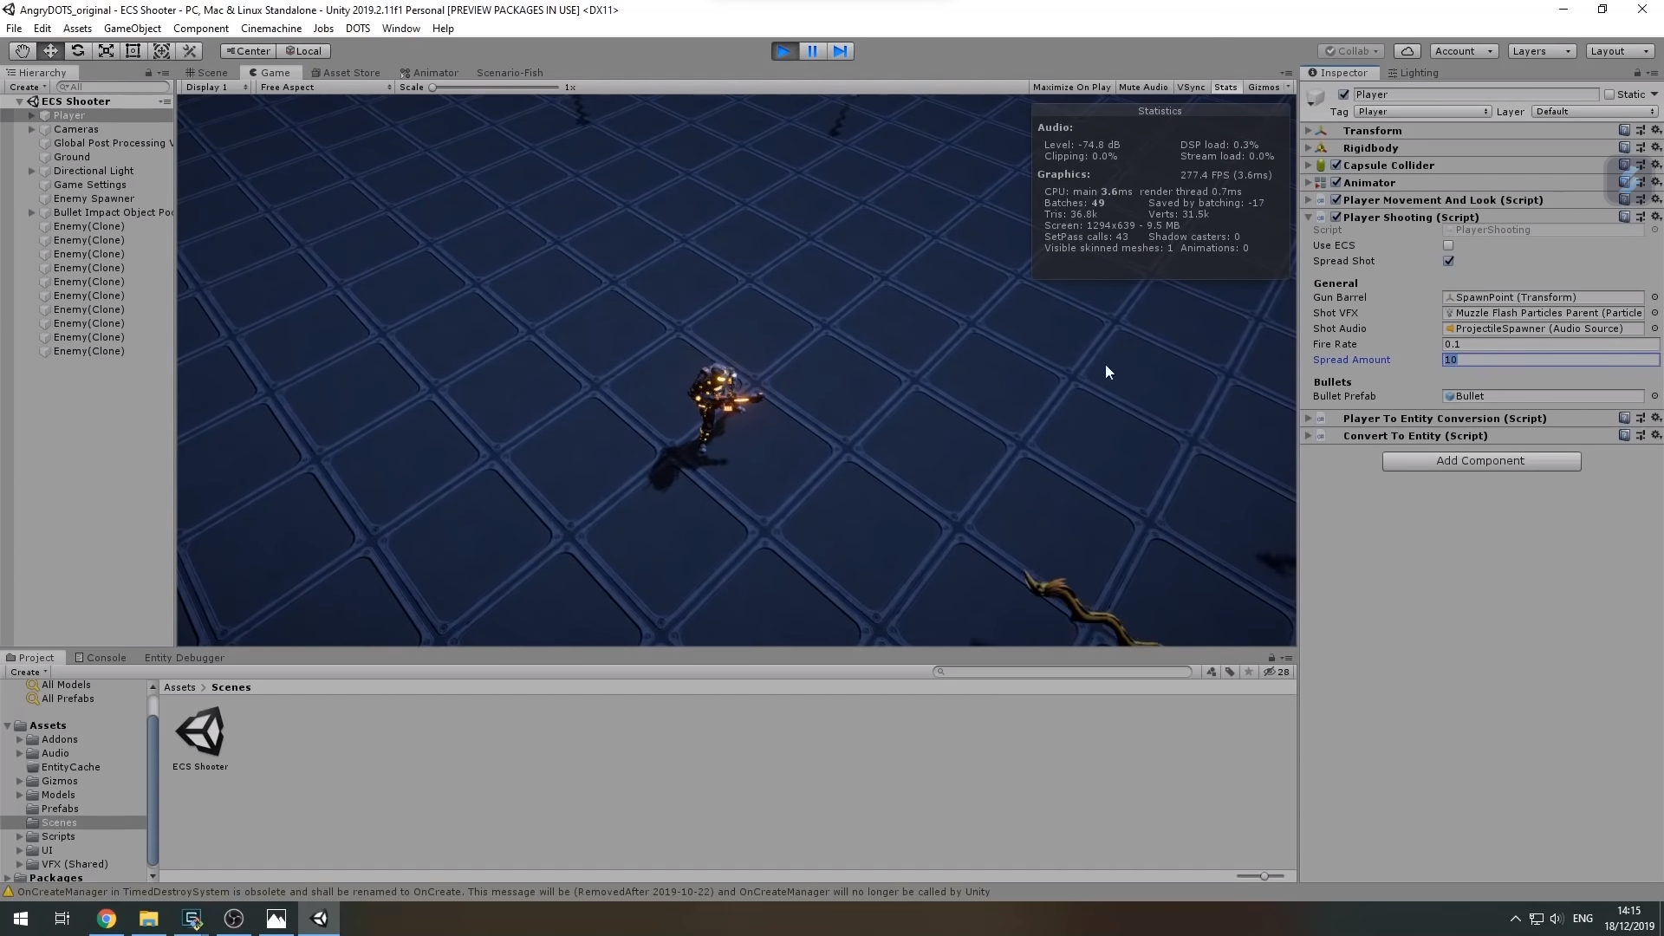
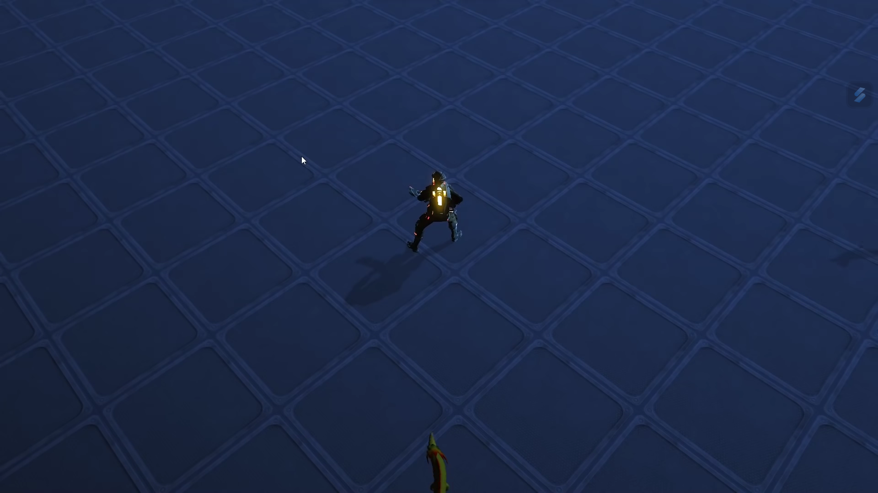
The Situation
Game In Unity
Similar game built with different methods. One in Unity and the other is Hand built.
The game built were tested in performance to see which one is faster.
Game built in WebGL
Notes:
For context. While learning about different Game engine, I was curious of the performance between a game built in unity and a game
Built using a hand-built game engine. I stumbled across a research done by this youtuber who wanted to find this difference and decided
to build a shooter game in both Unity and his hand-built Game engine using WebGL and a few other libraries.

Slide 6
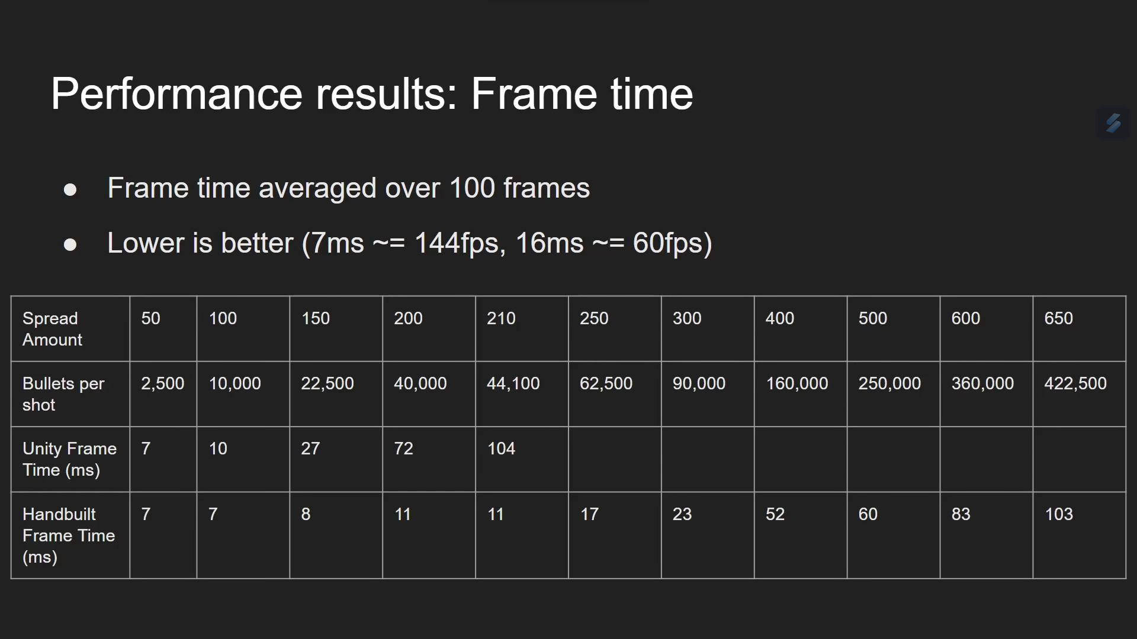
Notes:
So, he tested the performance of both games as he increase the bullets fired by the player. When looking at the performance between the two engines, u can see an exponential increase in frame time as the bullets increase in the Unity game engine.

Slide 7
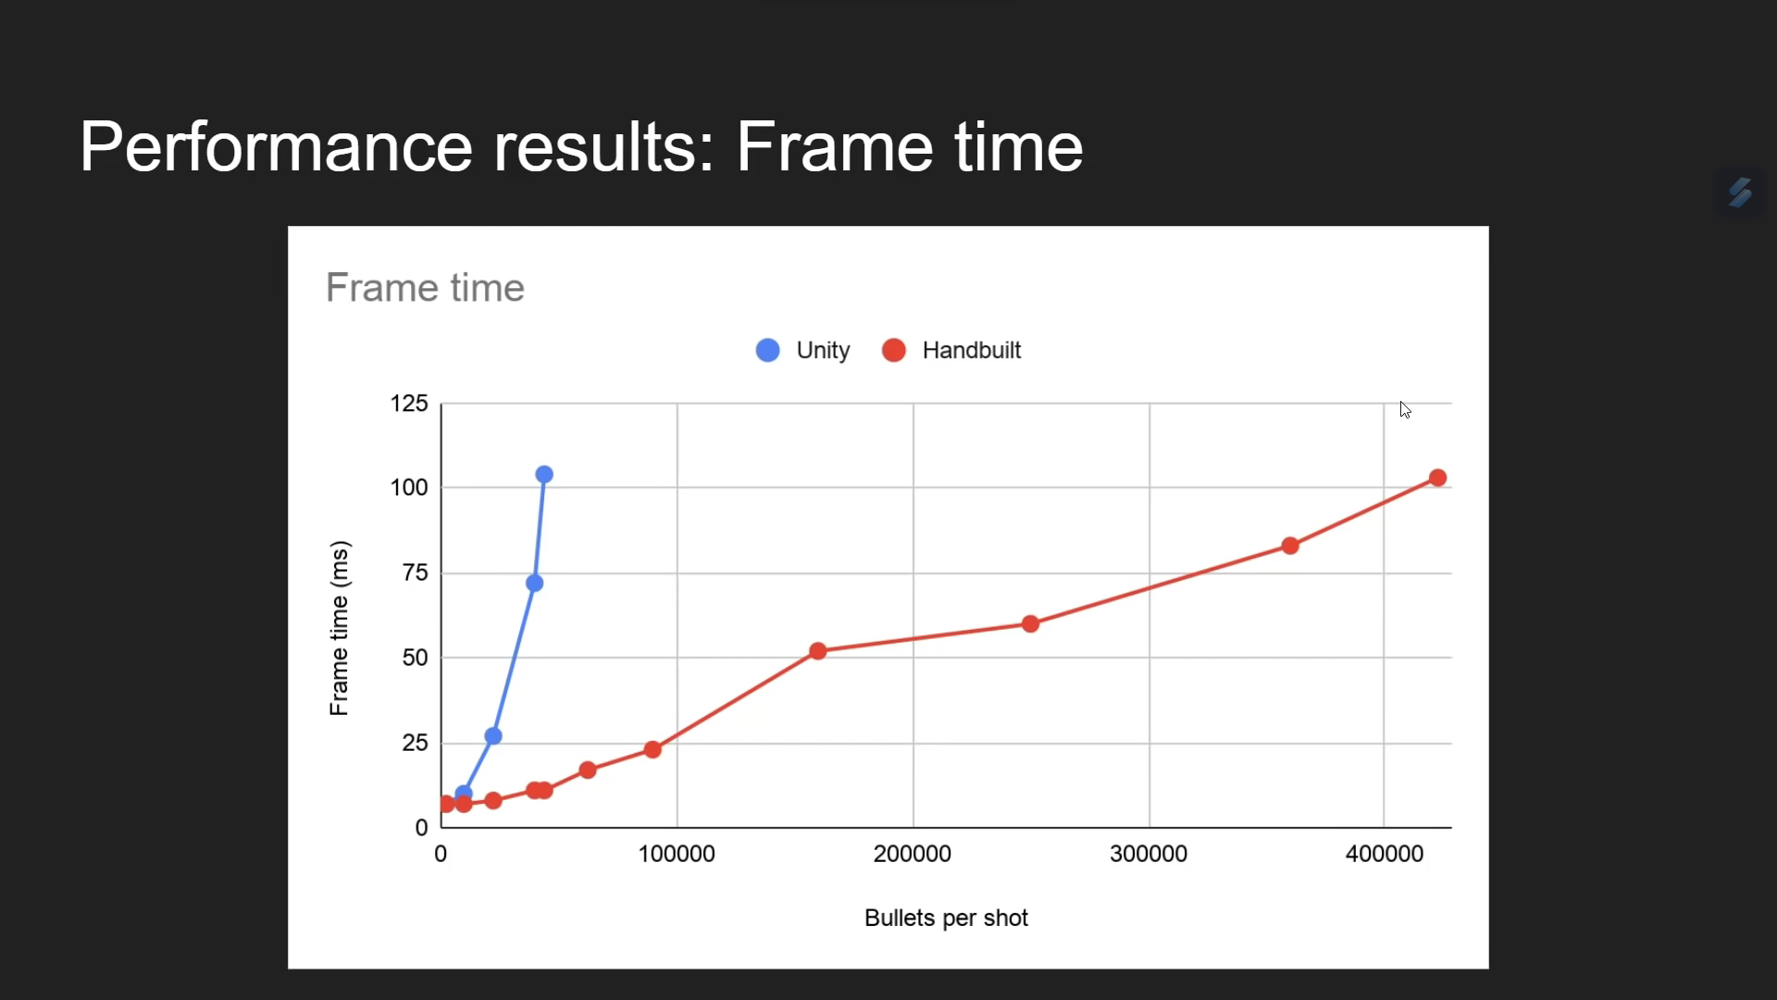
Notes:
U can see this graph that represent the performance of both game engines. Where u can see that Unity frame per second increase exponentially As the bullets increase. U can also see that the game in Unity runs slower as compared to Hand built when more bullets were fired.

Slide 8
Problem statement: similar game that runs In Unity have lower frame per seconds compared to hand built game engines especially when firing more Bullets (25 -30 MS slower)
Notes:
This leads me to construct my problem statement which is that similar game run in Unity
Have lower frame per second as compared to hand-built game engine. Especially when firing more bullets. This performance decrease can be around 25 – 30 Ms slower.

Slide 9
Finding Causation of problems
How I be finding the root problems
Notes:
So how would I try find the root cause of the problem as to why Unity run slower compared to the hand built engine

Slide 10
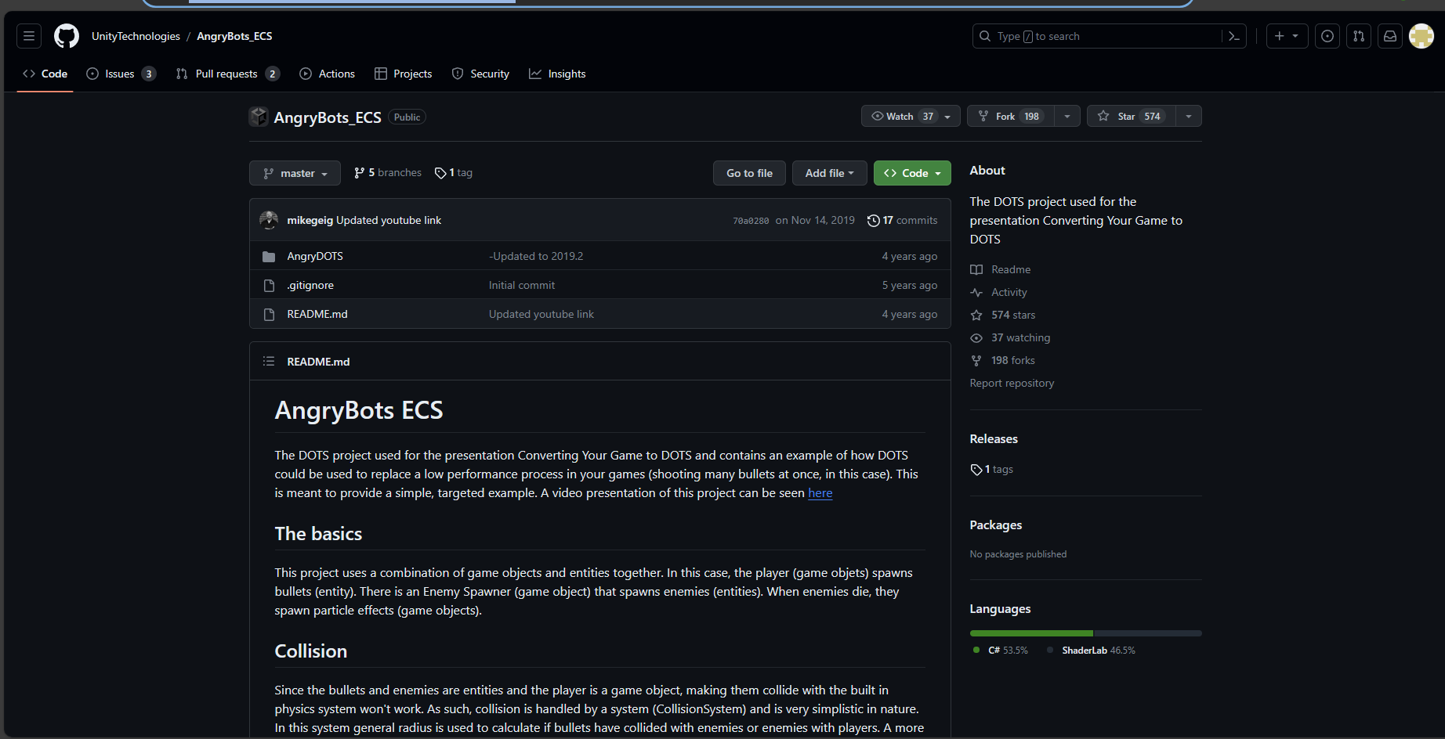
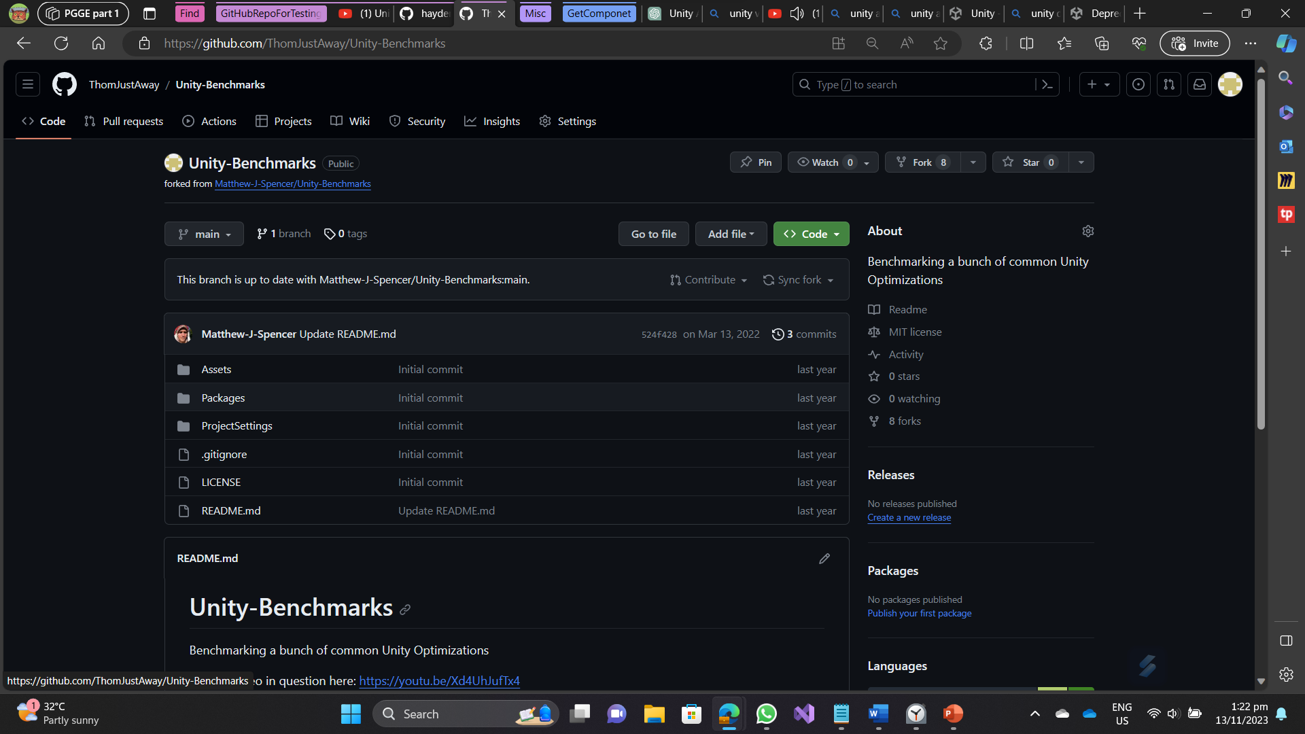
What tools will I be using
Unity
repo
Using Unity Project (using a special Github Repo to do bench marking and testing the performance of the API)
Profiler (to see time taken to complete a task)
Benchmarking Repo: ThomJustAway/Unity-Benchmarks: Benchmarking a bunch of common Unity Optimizations (github.com)
Unity game repo: UnityTechnologies/AngryBots_ECS: The DOTS project used for the presentation Converting Your Game to DOTS (github.com)
Replicating code from the unity game and
Benchmarking it to test performance of the
API used
Benchmarking
repo
Notes:
I decided to focus my intention on the API of UNITY and decided to do benchmarking on the API using a repository I found online.
I will be going through the game created in unity and test the API using that benchmarking Repository.
I will be using the profiler as well to see the performance and runtime of the programmes.

Slide 11
What is the root cause?
What are some cause to the problem?
Notes:
So, what are the root causes I found from the benchmark

Slide 12
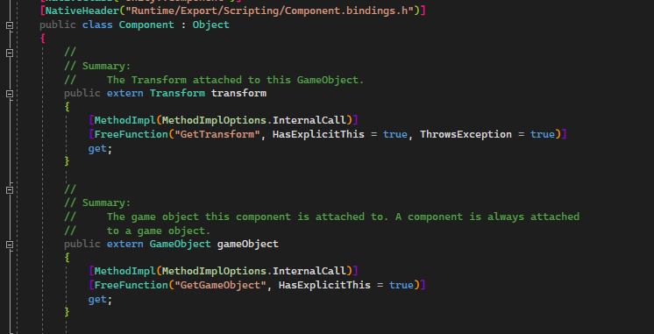
Extern calls
Runs slower as it must go to the C++ code base to get information.
Applies for API like Transform, Rotation and GameObject
Must take extra steps to retrieve data from the C++
Notes:
So one of the problem can cause low performance is extern calls. Unity will have to go to its C++ code base to
retrieve information before returning to the C# code base. This make retrieve information from APIs like
Transform and Game object to be a bit slow since the code has to retrieve information from C++.

Slide 13
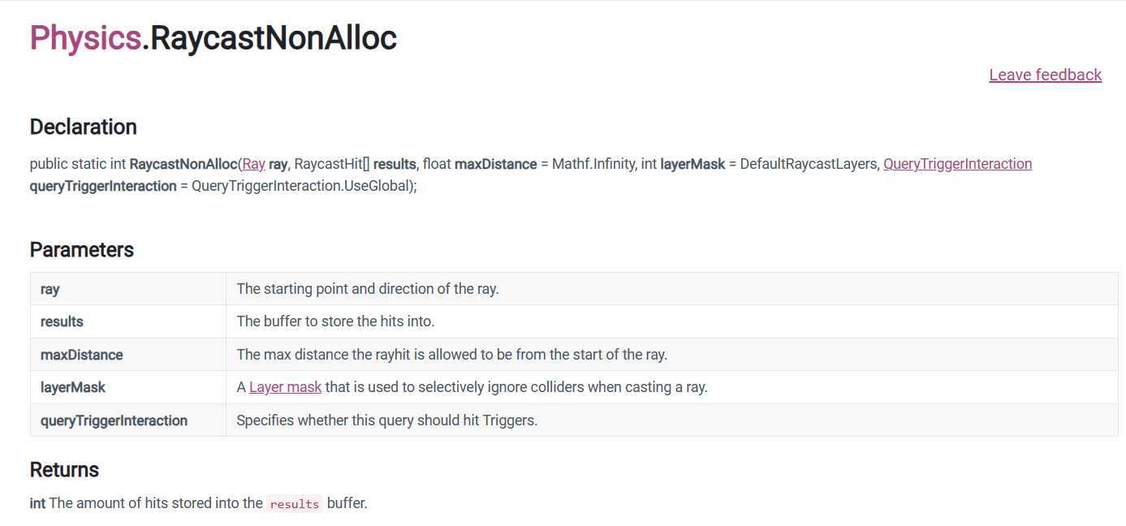
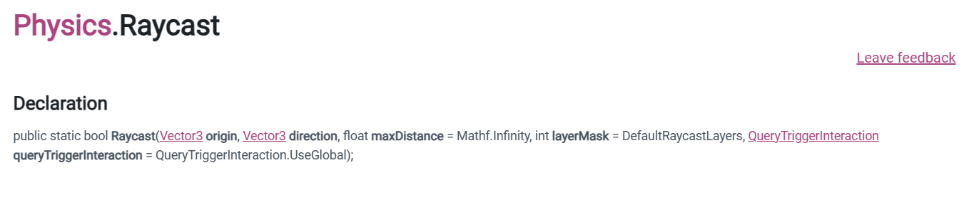
Trade-Off
Other API will have trade-off. Where they reduce their performance to perform better in other areas
Can be seen in API like Physic.RaycastNonAlloc and Physics.Raycast.
Does the same thing
No garbage collection
Slower performance
Faster Performance
Requires garbage collection
Notes:
Next is the trade-off. Some APIs would have to sacrifice performance to do better in other areas. One such example is Raycasting and raycastingNonAlloc. Where those two does same function
But nonalloc version is slower but does not require garbage collections.

Slide 14
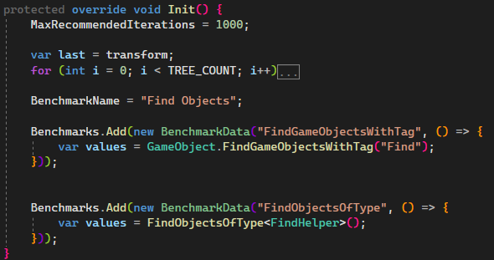
Use of Computationally expansive functions
Some API would use computationally expansive Function like square root or exponential.
This can be seen in API like Vector3.Distance , Shader, Find APIs
FindObject() known to be computationally expansive as it was told in one of the developers in Unity GDC.
Notes:
Lastly is the used of computationally expansive functions. So, some API requires this functions to complete their task. This can be seen in Vector3.Distance where it uses Math.sqrt(). This can be applied to the Findobjectbytag or FindObjects methods
Where Unity has to do some computational heavy function just to find the objects for developers to use.

Slide 15
How do reduce the effects of roots cause in your Projects?
What are some measure u can take to make your project more performant?
Notes:
After figuring out the root cause of why the API is slow, what are some work around to improve the performance of the game.

Slide 16
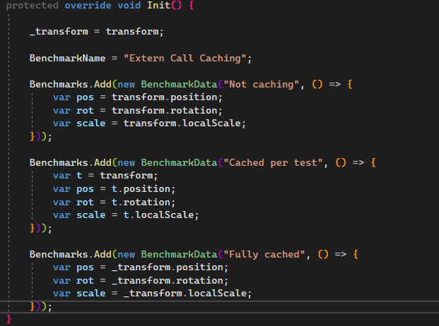
Caching result from Extern calls
Cache result from extern calls to reduce the calls made to the C++ side.
Notes:
One way is to cache the result from APIs like Transform or Gameobject as to reduces the extern calls made in the C++ side.

Slide 17
Swapping to APIs that runs faster
Use APIs that runs fasters.
Examples (like using Physics.RayCast instead of Physics.RayCastNonAlloc)
Notes:
Another way to improve would be to use api with better performance.

Slide 18
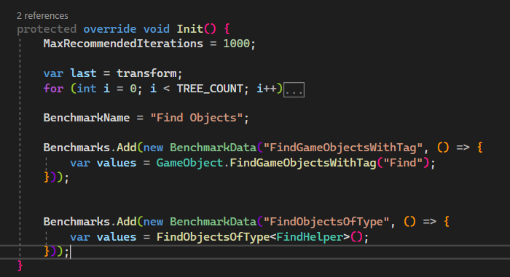
Place the inefficient API correctly
Know where to place inefficient APIs in the code.
Helpful but slow API like this are recommended to use in Start() / Awake() function Instead of Update
Notes:
Lastly, placement of the API is important. For example, using the find API like FindGameObjectsWithTag or FindObjectsOfType to start or awake function rather than the Update function can help reduce frame time increase in the game.

Slide 19
Conclusion
Know the best practices to optimize code
Understand where you should use computationally expansive code
Use APIs that are more performant
Notes:
In conclusion, though it is hard to make games in unity that can perform better compared to games builts using hand-built game engine due to reason like APIs, there are way to improve game Performance in Unity that can reduce this bottlenecks. Knowing the best practices of handling APIs can help improve performance of the Unity game and as well as using better performing APIs and knowing where to use said APIs can help boost runtime performance.
Though I did not cover much about the different optimization tricks in this video,
it is good idea to figure out if you are writing code wrongly and if You should optimize them. Thank you for listening and happy coding.

